Slide 1
Unit - 4
HANDLING TIME SERIES AND SPATIAL DATA

Slide 2
INTRODUCTION
This unit focuses on the techniques and methodologies for effectively managing and analyzing time series and spatial data, which are crucial for various applications in data science, urban planning, environmental monitoring, and more.

Slide 3
Preprocessing Time Series Data
In this section, we explore key preprocessing techniques to prepare time series data for analysis:
Resampling: Adjusting the frequency of data points. For example, converting daily stock prices into weekly averages to observe broader trends.
Interpolation: Filling in missing values. For instance, if temperature readings are missing for a few days, interpolation can estimate those values based on surrounding data.
Rolling Windows: Using moving averages to smooth data. An example is calculating a 7-day moving average of website traffic to identify trends while reducing daily fluctuations.

Slide 4
Spatial Data Wrangling Techniques
This part covers methods for organizing and manipulating spatial data:
Geocoding: Converting addresses into geographic coordinates. For example, turning a list of customer addresses into latitude and longitude for mapping.
Spatial Joins: Combining datasets based on spatial relationships. For instance, joining demographic data with geographic boundaries to analyze population characteristics in different regions.
Spatial Queries: Extracting information based on location. An example would be querying a database to find all parks within a 1-mile radius of a specific point in a city.

Slide 5
Handling Special Data Types
Here, we address the challenges of processing non-traditional data formats:
Images: Techniques like image classification using neural networks to identify objects within photos (e.g., identifying species in wildlife photography).
Audio: Processing sound data to classify different types of music or recognize spoken commands.
Video: Analyzing video data to detect activities or track movements, such as monitoring traffic patterns from surveillance footage.

Slide 6
Integrating External Datasets with GIS
This section emphasizes the importance of combining external datasets with Geographic Information Systems (GIS):
For example, integrating weather data with geographic data to analyze how different weather patterns affect crop yields in various regions. Another example could be combining health data with population density maps to identify areas at higher risk for disease outbreaks.
Overall, this unit provides essential techniques for preprocessing, analyzing, and integrating time series and spatial data, empowering learners to draw meaningful insights from complex datasets.

Slide 7
Resampling
Resampling refers to the process of converting a time series from one frequency to another. Aggregating higher frequency data to lower frequency is called downsampling, while converting lower frequency to higher frequency is called upsampling.
Not all resampling falls into either of these categories; for example, converting W-WED (weekly on Wednesday) to W-FRI is neither upsampling nor downsampling.

Slide 8
pandas objects are equipped with a resample method, which is the workhorse function for all frequency conversion. resample has a similar API to groupby; you call resample to group the data, then call an aggregation function:

Slide 9
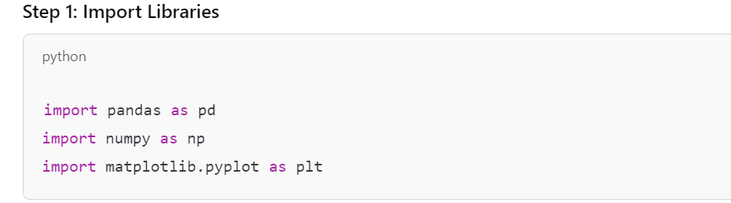

Slide 10
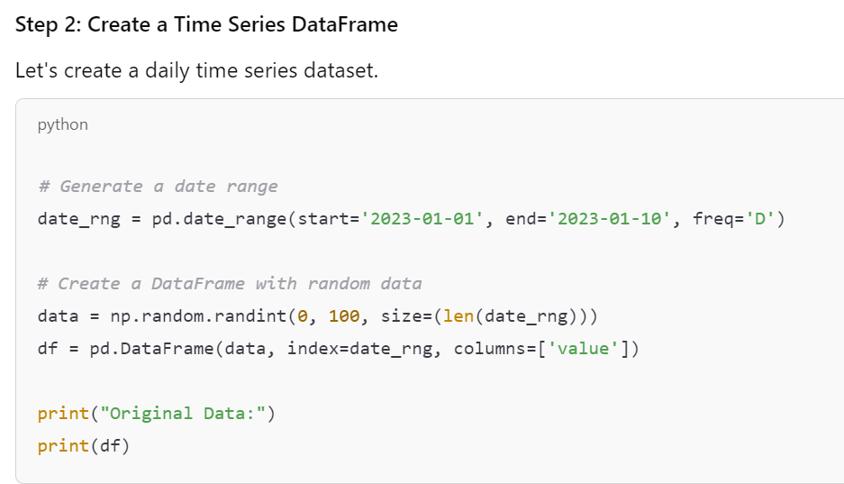

Slide 11
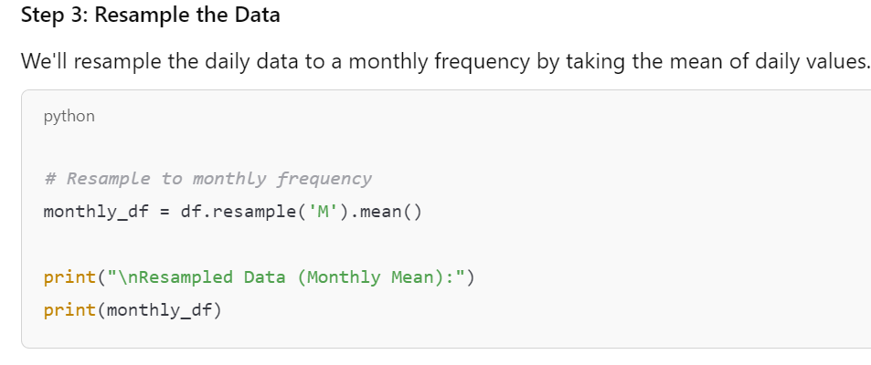

Slide 12
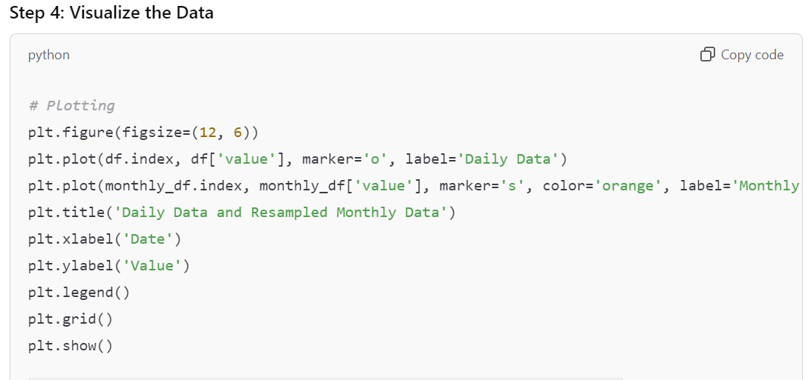

Slide 13
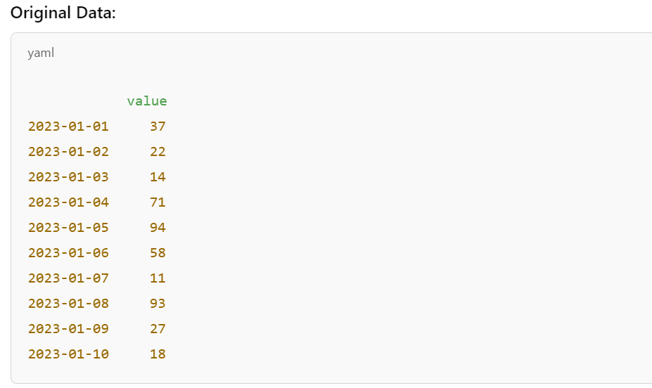
Output:

Slide 14
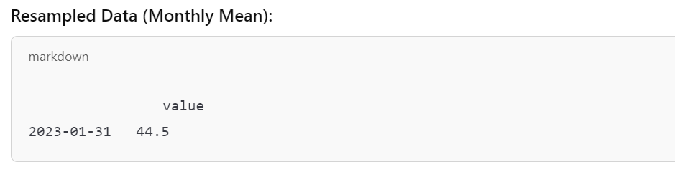

Slide 15
Applications of Resampling
Data Aggregation: Helps in reducing the volume of data while retaining essential trends and patterns.
Time Series Analysis: Useful in forecasting, anomaly detection, and seasonal decomposition.
Reporting and Dashboarding: Provides summarized data for dashboards and reports.

Slide 16
Advantages of Resampling
Simplicity: Makes data easier to work with by reducing complexity.
Noise Reduction: Aggregating data can help minimize the impact of noise and outliers.
Trend Analysis: Facilitates better trend analysis and visualizations by smoothing out fluctuations.

Slide 17
Disadvantages of Resampling
Loss of Information: Important details may be lost when aggregating data.
Bias: The choice of aggregation function (mean, sum, etc.) can introduce bias.
Overfitting: If data is over-sampled without proper handling, it might lead to overfitting in models.

Slide 18
Interpolation
Interpolation is a technique used to estimate missing values in a dataset. In time series data, missing values can occur due to various reasons, such as sensor failures, data collection issues, or other anomalies. Interpolation helps create a continuous dataset, which is crucial for analysis and modeling.

Slide 19
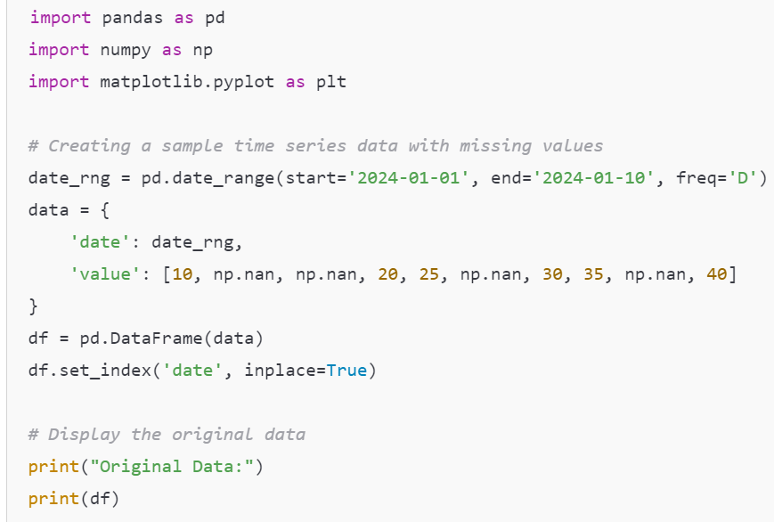

Slide 20
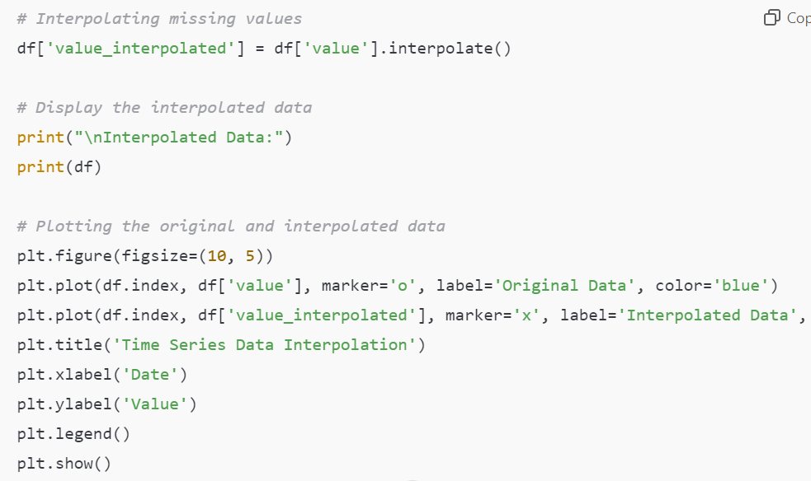

Slide 21
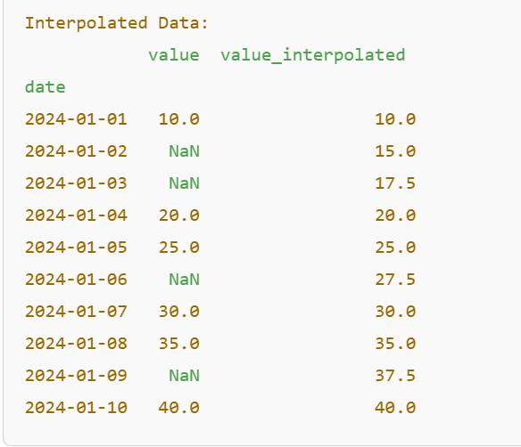
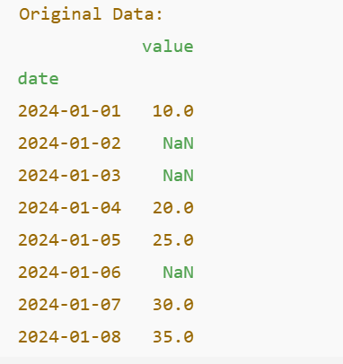
Output :

Slide 22
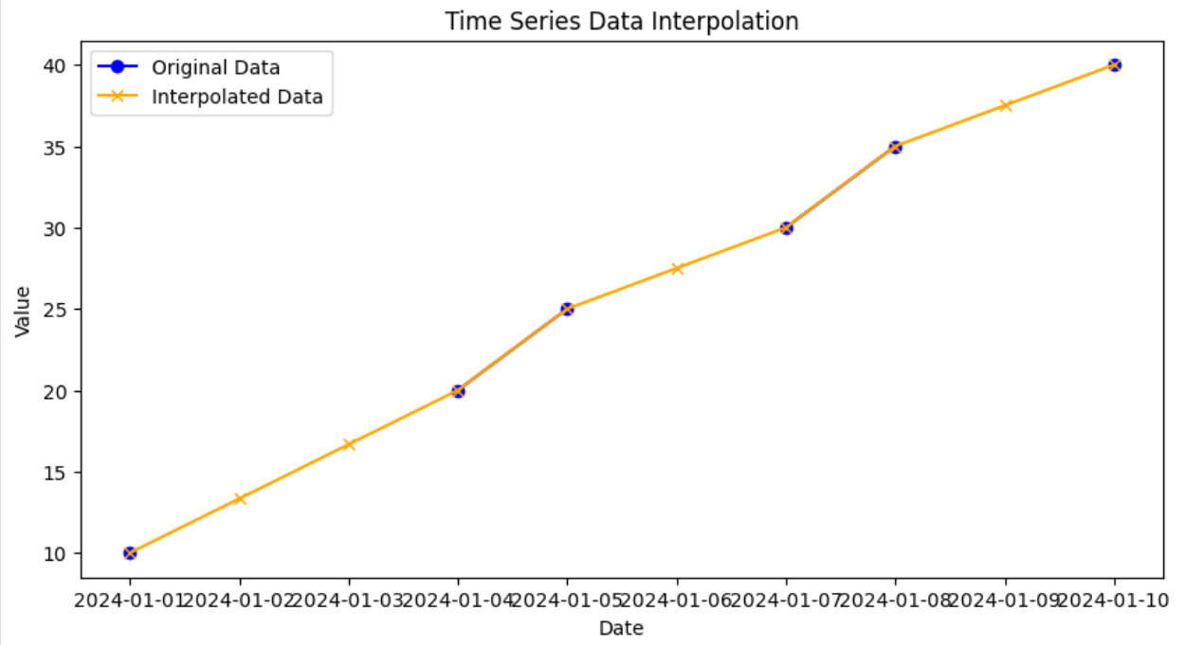

Slide 23
Applications of Interpolation
Data Cleaning: Filling missing values in sensor data, financial records, or time series forecasts.
Signal Processing: Enhancing signals by estimating values at missing time points.
Weather Data: Filling in gaps in meteorological data to ensure smooth analysis.
Stock Prices: Estimating prices when trading data is not available.

Slide 24
Advantages of Interpolation
Maintains Data Continuity: Helps create a smoother time series for analysis.
Improves Model Performance: Models can learn better from complete datasets.
Various Methods Available: Offers multiple methods (linear, polynomial, spline) for different scenarios.

Slide 25
Disadvantages of Interpolation
Assumption Dependency: Assumes that the data behaves in a specific way (e.g., linear), which may not always hold true.
Can Introduce Bias: If the underlying pattern is not captured, it might mislead analysis or predictions.
Overfitting: In some cases, complex interpolation methods can fit noise rather than the underlying signal.

Slide 26
Rolling Windows
Rolling windows, or moving windows, are a technique used in time series analysis to calculate statistics over a specified number of observations. This method is especially useful for smoothing time series data, identifying trends, and generating new features for analysis.

Slide 27
Concept of Rolling Windows
A rolling window involves taking a subset of data points over a specified number of time steps (the window size) and performing calculations (like mean, sum, etc.) on that subset. As the window moves along the data, it generates a new series of computed values.

Slide 28
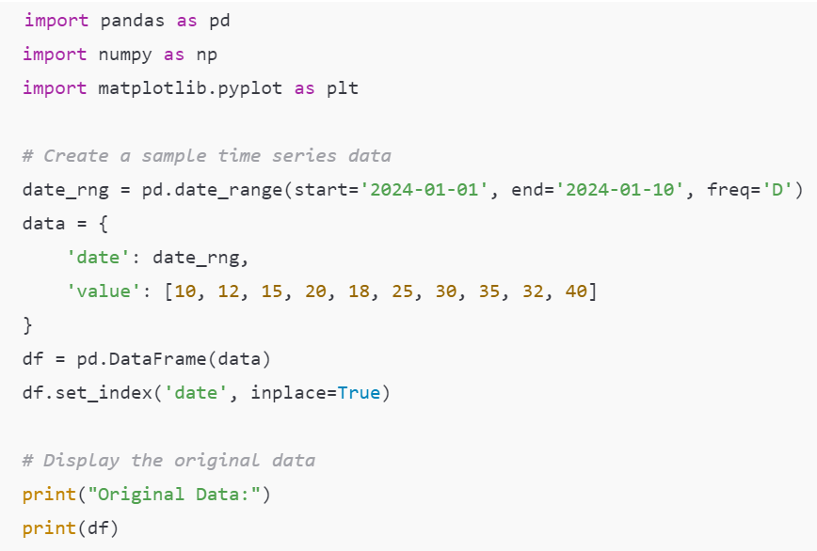

Slide 29
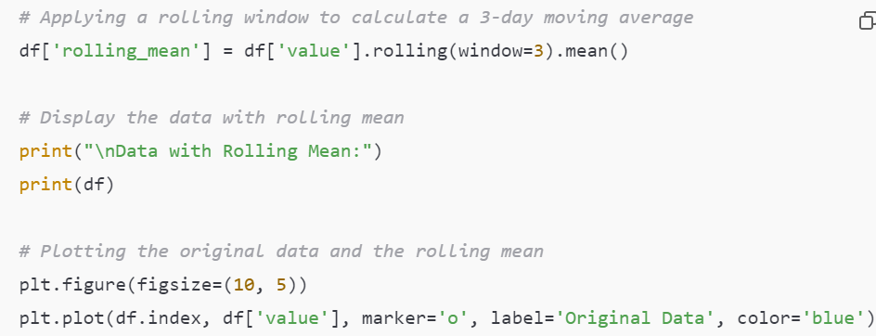

Slide 30
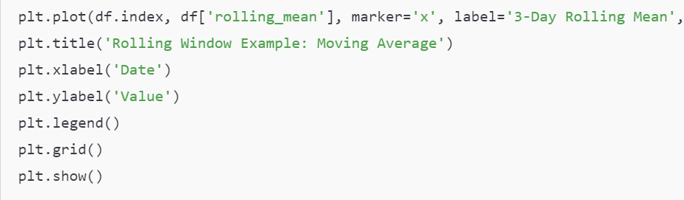


Slide 31
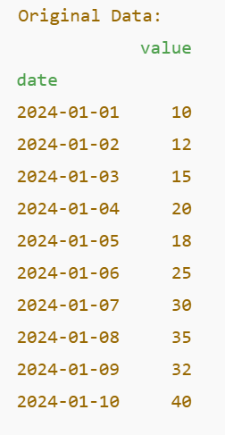
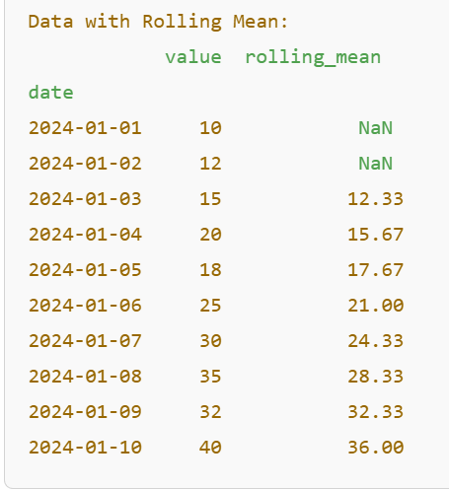
Output:

Slide 32
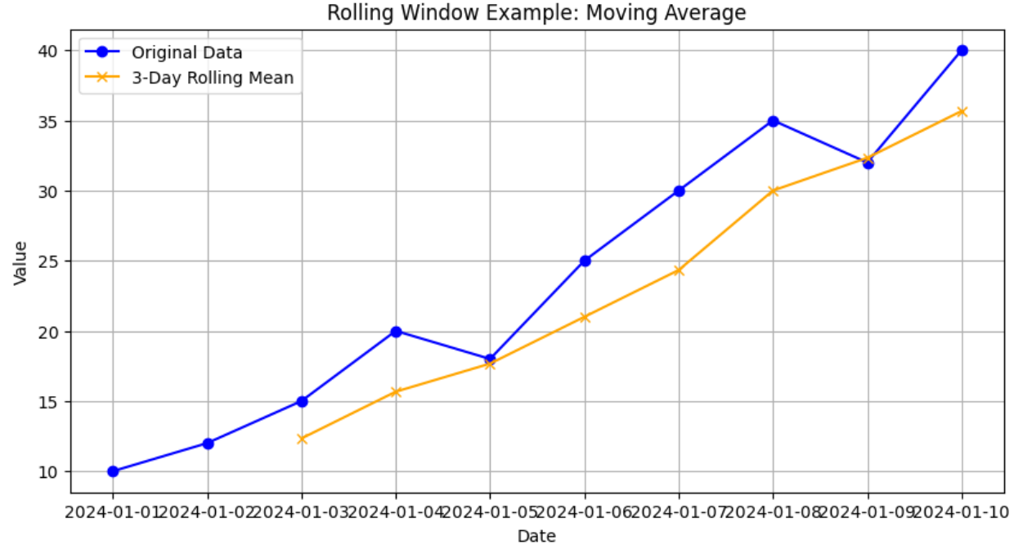

Slide 33
Applications of Rolling Windows
Smoothing Data: Rolling windows help in reducing noise and making trends easier to identify in time series data.
Feature Engineering: In machine learning, rolling statistics can be used as features that capture the recent history of data.
Anomaly Detection: Comparing current data points against rolling statistics can help identify outliers or anomalies.
Financial Analysis: Commonly used in stock price analysis to calculate moving averages, which help traders make decisions.

Slide 34
Advantages of Rolling Windows
Trend Identification: Smooths out short-term fluctuations to help identify long-term trends.
Flexibility: Can compute various statistics (mean, median, sum, standard deviation) across different window sizes.
Data Reduction: Summarizes large datasets effectively, making them easier to analyze and visualize.

Slide 35
Disadvantages of Rolling Windows
Loss of Detail: Smoothing may hide important short-term variations or anomalies in the data.
Window Size Sensitivity: The choice of window size significantly impacts results; a window that is too small may not capture trends, while a window that is too large may oversmooth the data.
Initial NaNs: The first few values of the rolling statistic will be NaN until the window is filled, which requires handling in analysis.

Slide 36
Spatial Data Wrangling Techniques: Geocoding
Geocoding is the process of converting addresses, place names, or other geographic identifiers into geographic coordinates (latitude and longitude). This technique is essential in spatial data analysis, as it allows for the visualization of data on maps and enables spatial operations.

Slide 37
Why Geocoding is Important
Geocoding transforms qualitative location data into quantitative data, making it possible to analyze and visualize locations in a geographic context. This is particularly useful for businesses, urban planning, logistics, and various research fields.

Slide 38
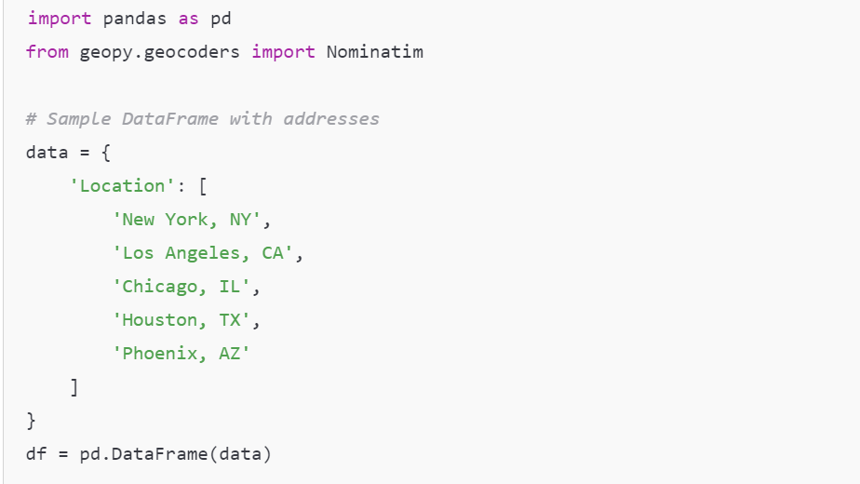
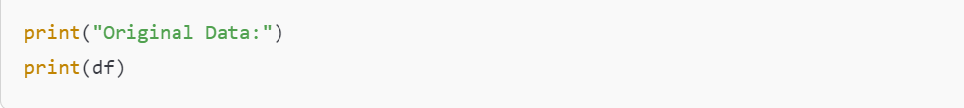
Import Libraries: We'll start by importing the necessary libraries.

Slide 39
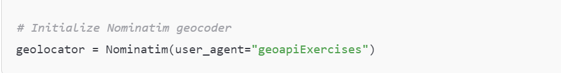
Initialize the Geocoder: We create a geocoder object using the Nominatim service.

Slide 40
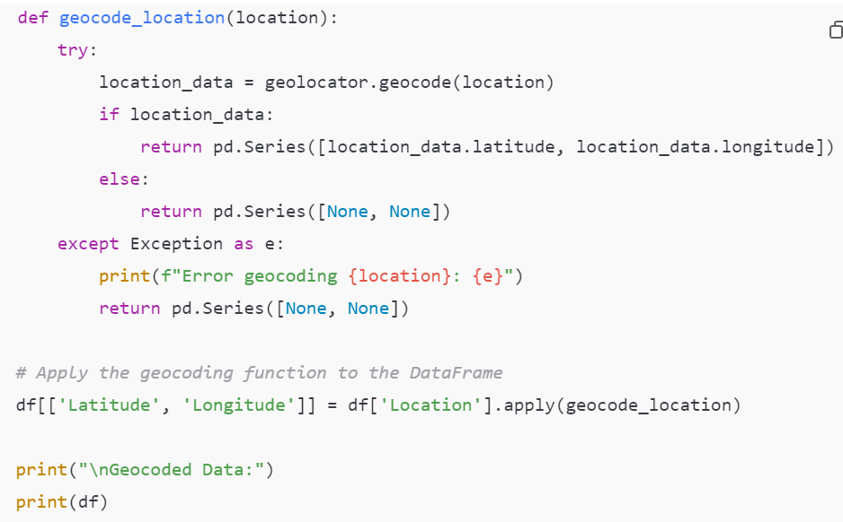
Geocode Locations: We will define a function to get the latitude and longitude for each address.

Slide 41
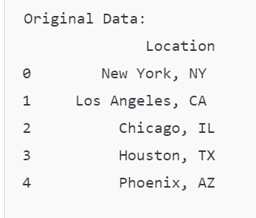
Output:

Slide 42
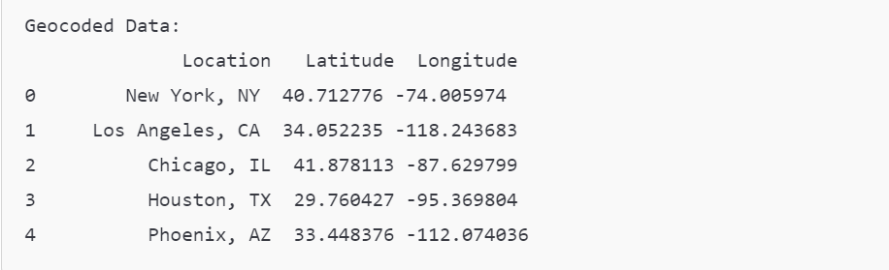

Slide 43
Applications of Geocoding
Mapping and Visualization: Plotting locations on maps for analysis and presentation.
Location-Based Services: Enhancing applications that rely on user location data (e.g., food delivery).
Urban Planning: Supporting city planners in visualizing infrastructure and population density.
Market Analysis: Identifying customer distribution and optimizing service areas.

Slide 44
Advantages of Geocoding
Transformative: Converts qualitative data into a format suitable for quantitative analysis.
Integration: Works seamlessly with GIS tools and mapping libraries (e.g., Folium, Matplotlib).
Improves Insights: Enhances understanding of spatial relationships and patterns.

Slide 45
Disadvantages of Geocoding
Data Quality Dependency: The accuracy of geocoding relies on the completeness and correctness of input addresses.
Rate Limits: Many geocoding services have usage limits, which may restrict batch processing of large datasets.
Cost: While some services are free, high-volume usage may incur charges.

Slide 46
Spatial Joins
Spatial joins are essential for combining datasets based on their geographic relationships, enabling more insightful spatial analyses. They allow you to merge attributes from two spatial datasets based on their spatial locations.
What is a Spatial Join?
A spatial join combines two datasets—typically, one containing geometric shapes (like polygons) and the other containing points or other geometric types (like lines). The join is based on the spatial relationship between the geometries (e.g., whether points are inside polygons, whether geometries intersect, etc.).

Slide 47
Example
Libraries RequiredYou’ll need the geopandas library for spatial data manipulation. If you don't have it installed, you can install it via pip:
pip install geopandas
Creating Sample Data
Let’s create two GeoDataFrames: one for schools (as point data) and another for neighborhoods (as polygon data).

Slide 48
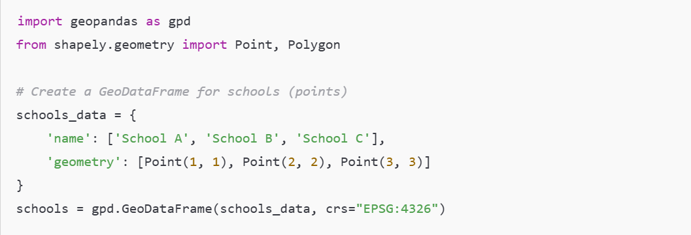

Slide 49
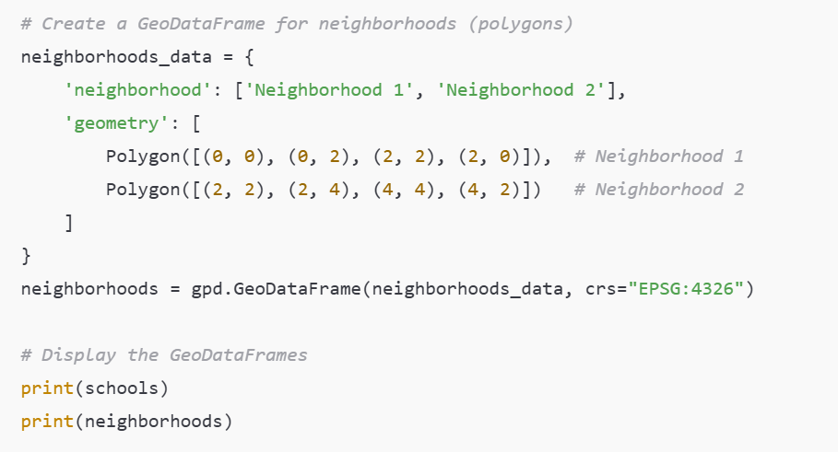

Slide 50
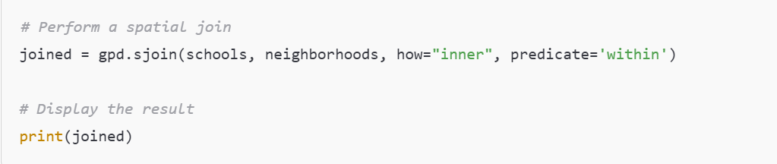
Performing a Spatial Join
We will now perform a spatial join to determine which school is located within which neighborhood.

Slide 51
Applications of Spatial Joins
Urban Planning: Assessing service distribution (like schools, hospitals)
within various urban areas.
Environmental Studies: Analyzing the spatial relationship between
protected areas and urban development.
Public Health: Mapping health facilities in relation to population density
areas to optimize service delivery.
Transportation Planning: Identifying intersections of transport routes
with residential areas for accessibility studies.

Slide 52
Advantages of Spatial Joins
Comprehensive Analysis: Combines multiple datasets based on location, providing deeper insights into spatial relationships.
Data Integration: Facilitates the integration of various types of spatial data, enriching analyses.
Automated Matching: Automates the tedious process of matching records based on geography.

Slide 53
Disadvantages of Spatial Joins
Performance: Spatial joins can be computationally intensive, especially with large datasets, leading to longer processing times.
Complexity: Understanding spatial relationships and their implications requires specialized knowledge in GIS (Geographic Information Systems).
Data Quality Issues: Inaccurate or poorly defined geometries can result in incorrect join results, impacting the reliability of analyses.
Handling Edge Cases: Situations such as overlapping geometries or ambiguous spatial relationships can complicate the join process.

Slide 54
Spatial Queries
Spatial queries allow users to retrieve and analyze data based on geographic location and spatial relationships. These queries can help you answer questions such as "Which points are within a certain distance from a polygon?" or "What are the intersections between different geometries?“
What is a Spatial Query?
A spatial query uses spatial relationships to filter data. This can include operations like checking if one geometry contains another, if two geometries intersect, or if points are within a certain distance from a line or polygon.

Slide 55
Example
Libraries RequiredYou will need the geopandas library, along with shapely for geometric operations. Ensure you have these installed:
pip install geopandas shapely

Slide 56
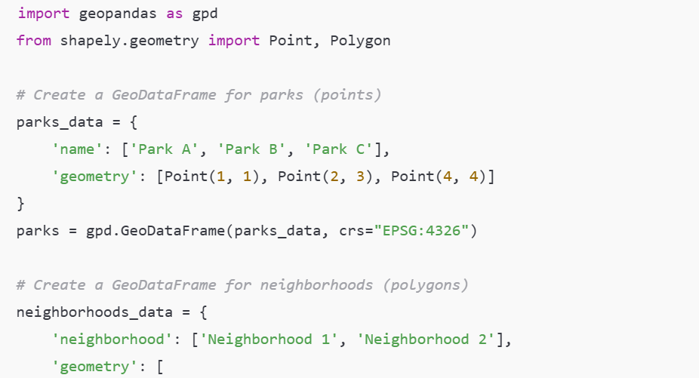
Creating Sample Data
Let’s create a simple example with points and polygons.

Slide 57
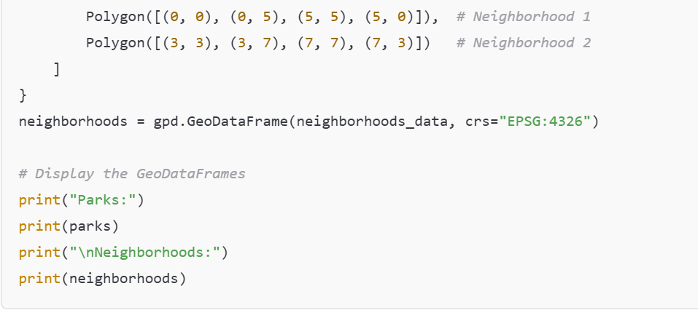

Slide 58
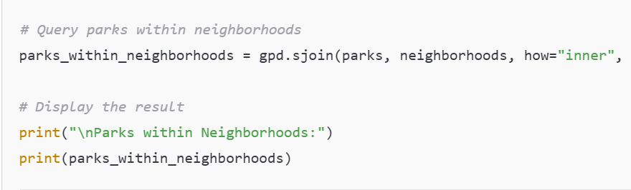
Performing Spatial Queries
Query 1: Finding Parks Within Neighborhoods
We will find out which parks are located within neighborhoods.

Slide 59
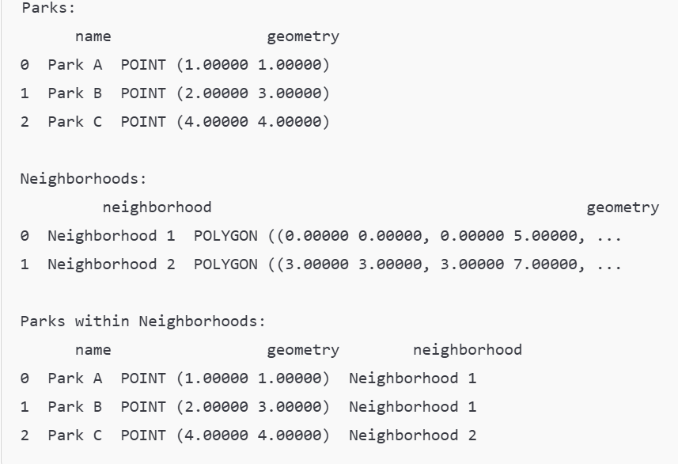
Output:

Slide 60
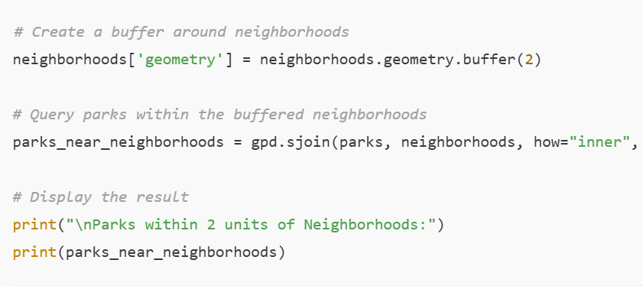

Query 2: Finding Parks Within a Certain Distance
Next, let’s find parks that are within a distance of 2 units from any neighborhood.

Slide 61
Applications of Spatial Queries
Urban Planning: Identifying parks, schools, or hospitals within certain distance thresholds for planning purposes.
Environmental Monitoring: Finding regions at risk based on proximity to pollution sources or protected areas.
Public Safety: Analyzing crime hotspots in relation to police stations or emergency services.
Transportation Analysis: Assessing accessibility of public transport to residential areas.

Slide 62
Advantages of Spatial Queries
Targeted Analysis: Allows for precise filtering of data based on spatial relationships.
Enhanced Decision-Making: Provides critical insights for planning and resource allocation.
Flexibility: Supports a wide range of spatial relationships and distance-based analyses.

Slide 63
Disadvantages of Spatial Queries
Computational Complexity: Spatial queries can be computationally expensive, especially with large datasets.
Data Quality: Inaccurate geometries can lead to misleading results, necessitating data cleaning and validation.
Requires GIS Knowledge: Understanding spatial relationships and query mechanisms requires familiarity with GIS concepts.

Slide 64
Handling Spatial Data Types: Images
Spatial data types, particularly images, play a significant role in various applications, including remote sensing, geographic information systems (GIS), and machine learning. Handling images involves techniques for reading, processing, and analyzing image data to extract useful information.

Slide 65
What Are Spatial Images?
Spatial images are often raster data represented in grid format, where each pixel corresponds to a geographic location. Each pixel has values representing attributes like color, intensity, or specific measurements (e.g., temperature, vegetation index).

Slide 66
Example of Handling Spatial Images
we'll use the PIL (Pillow) library for image processing and matplotlib for visualization. We will create a simple example where we load an image, perform some basic operations (like resizing and filtering), and visualize the results.
Ensure you have the necessary libraries installed:
pip install pillow matplotlib numpy

Slide 67
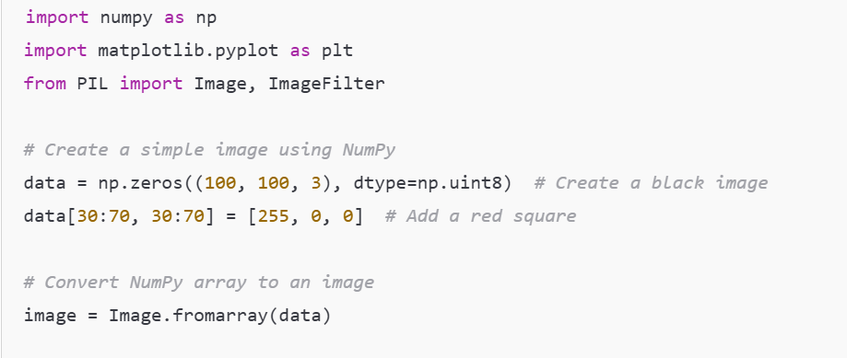
Creating a Sample Image
You can either use an existing image or create a simple one. Here’s how to create a simple image using NumPy and visualize it.

Slide 68
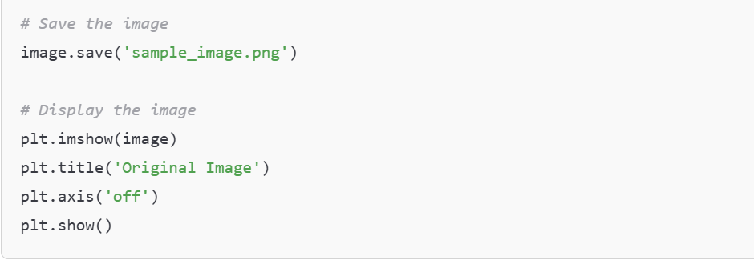

Slide 69
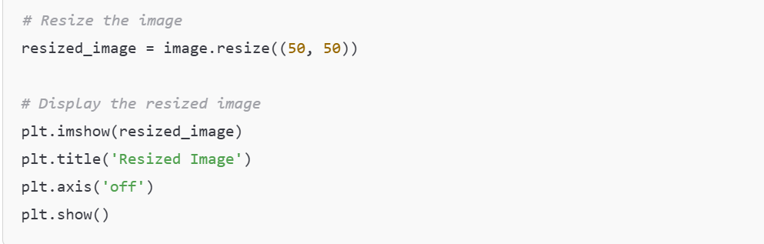
Performing Image Operations:
Now that we have our image, let's perform some basic operations: resizing and applying a filter.
Resize the Image

Slide 70
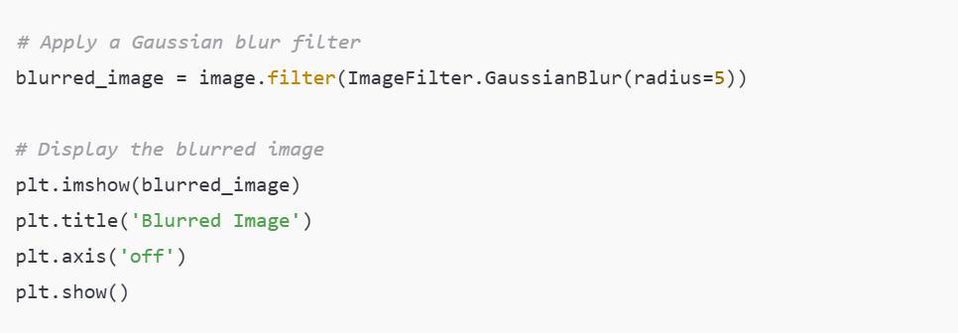
Apply a Filter

Slide 71
Output:
You will see three images:
The original image with a red square.
The resized image (50x50 pixels).
The blurred version of the original image.

Slide 72
Applications of Spatial Images
Remote Sensing: Analyzing satellite images for land cover classification, change detection, or environmental monitoring.
Medical Imaging: Processing MRI or CT scans for diagnostics and treatment planning.
Urban Planning: Using aerial images for land use planning and infrastructure development.
Agriculture: Analyzing drone images for crop health monitoring and precision farming

Slide 73
Advantages of Handling Spatial Images
Rich Information: Images can convey detailed information about the spatial characteristics of an area.
Wide Applications: Useful across many fields, including environmental science, urban studies, and healthcare.
Data Analysis: Enables the application of machine learning and computer vision techniques to extract patterns and insights.

Slide 74
Disadvantages of Handling Spatial Images
High Volume: Image data can be large, leading to challenges in storage, processing, and transmission.
Complexity: Analyzing images requires specialized knowledge and tools, such as image processing algorithms and machine learning techniques.
Quality Variability: Image quality can vary due to factors like sensor characteristics and environmental conditions, impacting analysis accuracy.

Slide 75
Handling special data types: audio
Handling audio data in Python involves dealing with raw sound files and performing operations like loading, processing, and saving audio in different formats. Audio data is typically stored in formats like WAV, MP3, or other compressed formats.

Slide 76
Common Libraries for Audio Handling in Python:
pydub: A high-level library for simple audio manipulation (e.g., converting, slicing).
librosa: A library for audio analysis, especially for tasks like feature extraction, visualization, and music information retrieval.
wave: A built-in module for working with WAV files.
soundfile: For reading and writing sound files, especially in formats like WAV and FLAC.

Slide 77
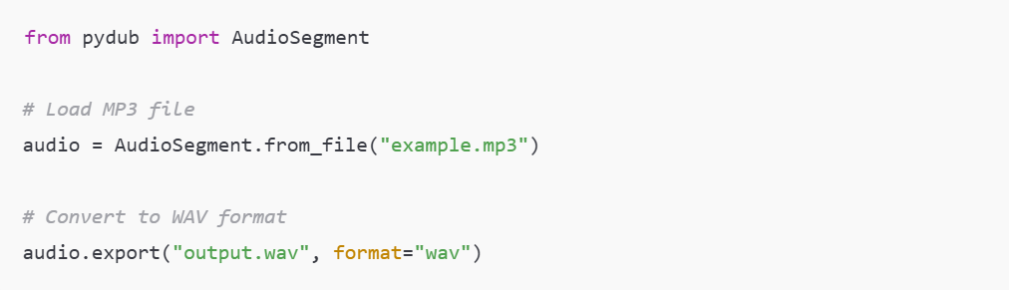
Using pydub to Convert Audio Format
Convert MP3 to WAV

Slide 78
Output:
Converts an MP3 file (example.mp3) into a WAV file (output.wav).
The output will be an uncompressed WAV file containing the same audio content as the input MP3 file.

Slide 79
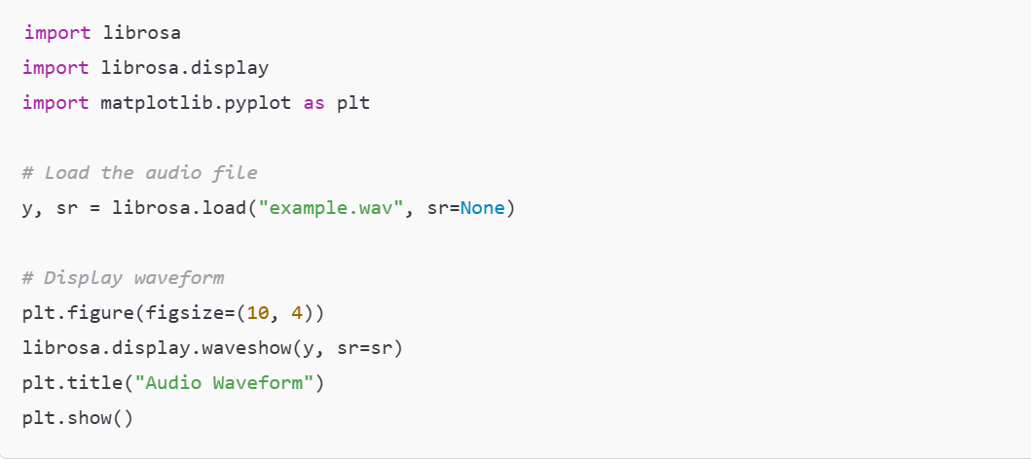
Using librosa to Analyze Audio
Visualize Audio Waveform

Slide 80
Output:
The waveform of the audio will be displayed as a plot showing the amplitude of the sound over time.
This visual representation helps understand the structure of the sound signal.

Slide 81
Advantages of Handling Audio
Ease of Use: Libraries like pydub and librosa provide simple APIs for common tasks like converting formats or displaying audio features.
Integration: Python integrates well with machine learning libraries (e.g., TensorFlow, PyTorch), making it easy to apply audio analysis in ML tasks.
Cross-Platform: Python libraries work across different operating systems (Windows, macOS, Linux), ensuring broad compatibility.
Open-Source: Most libraries are free and have strong community support.

Slide 82
Disadvantages of Handling Audio
Performance: Python is not ideal for real-time or performance-critical audio processing tasks. Languages like C or C++ may be more suitable for real-time systems.
Memory Usage: Large audio files (especially uncompressed ones) can consume significant memory, which may be inefficient for large datasets.
Complexity: Advanced tasks (e.g., speech recognition or noise filtering) may require a deeper understanding of signal processing and additional custom coding.External
Dependencies: Libraries like pydub depend on external tools like ffmpeg, which must be installed separately and can complicate deployment.

Slide 83
Handling Special Data Types: Video Data
Video data consists of a sequence of images (frames) displayed at a certain rate (frames per second). Each frame can be processed for tasks like object detection, tracking, or transformation. Python provides several libraries for handling video data, such as OpenCV, MoviePy, and PyTorch.

Slide 84
Key Steps in Handling Video Data
Reading Video Files: Use tools to load video data from files, webcams, or other sources.
Processing Frames: Apply transformations like grayscale conversion, object detection, or edge detection.
Displaying/Modifying Video: Visualize or modify frames for analysis or output.
Saving Processed Video: Store the output video after processing.

Slide 85
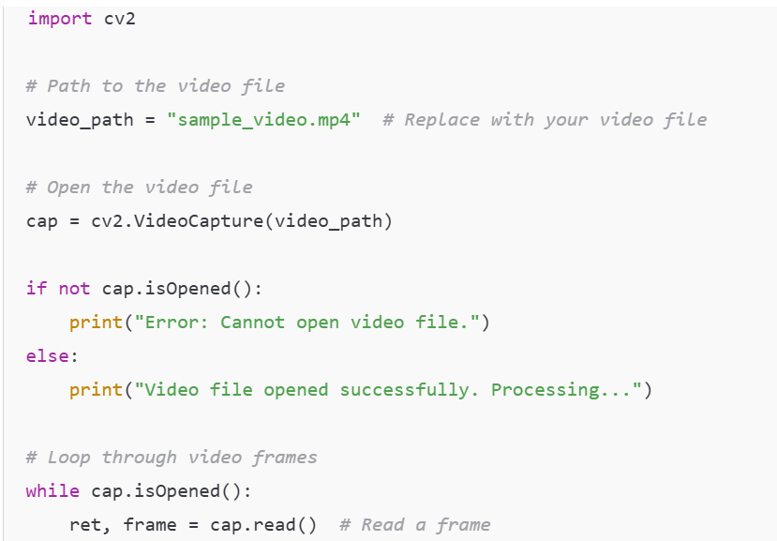
Handling Video Data with OpenCV

Slide 86
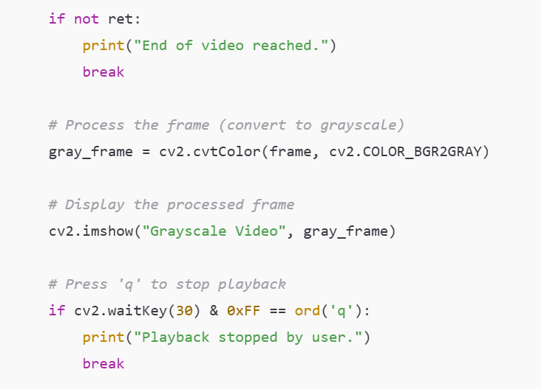

Slide 87
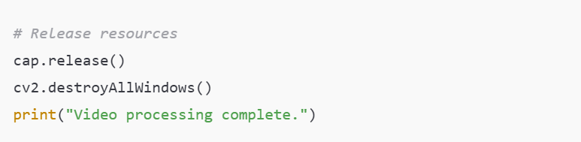
Output
Opens the specified video file.
Displays each frame of the video in a grayscale format in a pop-up window titled "Grayscale Video."
Stops playback when the user presses the q key or when the video ends.

Slide 88
Advantages :
Wide Support for Libraries:
OpenCV for video processing.
MoviePy for video editing.
TensorFlow/PyTorch for video-based machine learning.
Ease of Integration:
Combine with other tools for tasks like object detection or frame classification.
Platform Independence:
Python code works seamlessly across multiple platforms.
Rich Community:
Extensive documentation and community support.

Slide 89
Disadvantages:
Resource-Intensive: Video processing requires significant computational power and memory.
Complexity: Handling video data, especially real-time processing, can be complex.
Large Storage Requirements: High-resolution video files consume large amounts of storage.
Dependency on Hardware: May require specialized GPUs for tasks like deep learning with videos.

Slide 90
Applications:
Surveillance Systems: Real-time face or object detection in security cameras.
Autonomous Vehicles: Analyzing live video streams for navigation and object avoidance.
Healthcare: Video-based diagnostics (e.g., analyzing MRI scans or surgeries).
Entertainment: Video editing, special effects, and CGI rendering.
Sports Analytics: Analyzing player movements and tactics from match recordings.

